Slide 1
SoCal Ecosystem Leadership Forum 2023
EDA Funding Opportunities,
Economic Distress Criteria & Eligibility
Presented by
Deepak Bahl, Program Director
USC Center for Economic Development
bahl@usc.edu
October 18, 2023

Slide 2
Overview
EDA Current Open Funding Opportunities
Economic Distress Criteria
Eligibility Data
  Los Angeles County
  Orange County
  Riverside County
  San Bernardino County
  San Diego County
Investment Rates & Matching Share Requirements

Slide 3




Recently Closed

Slide 4
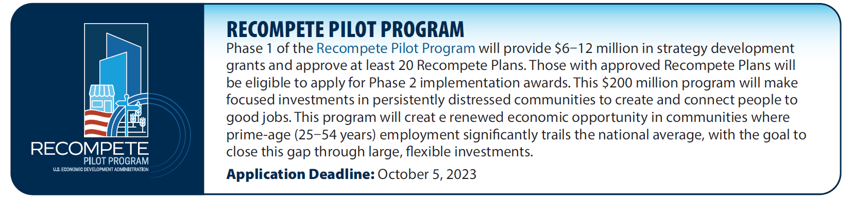
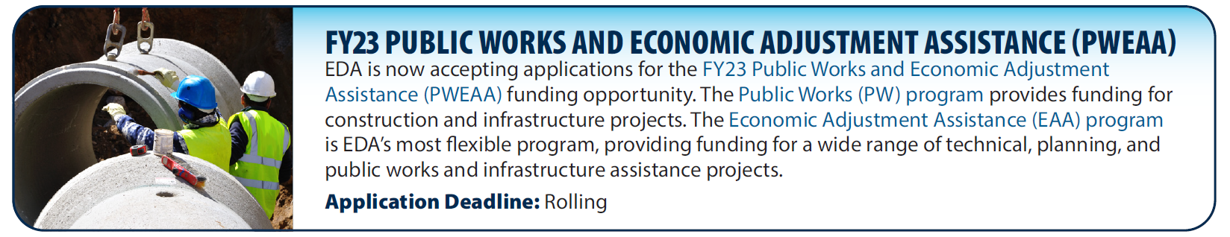
Recently Closed

Slide 5

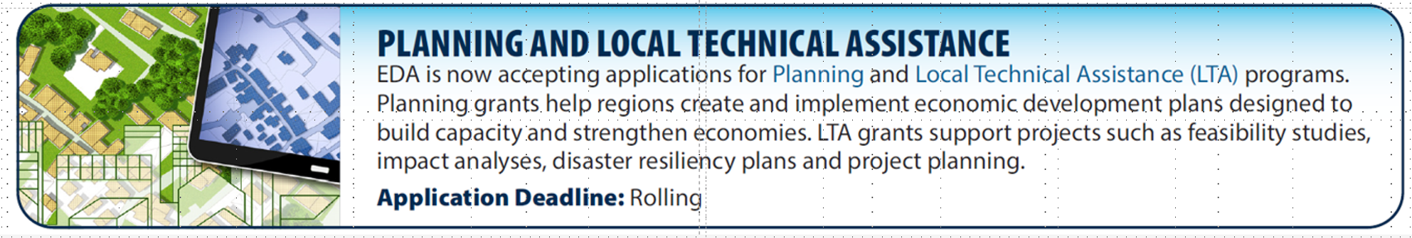

Slide 6
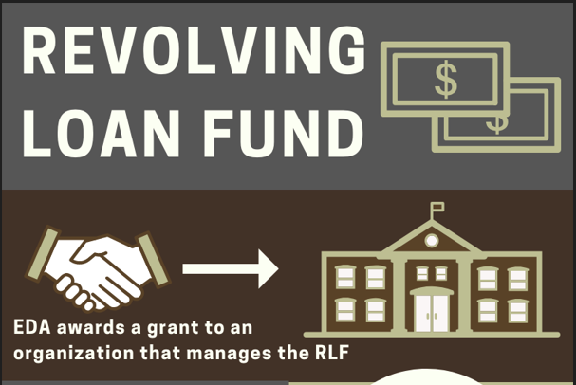
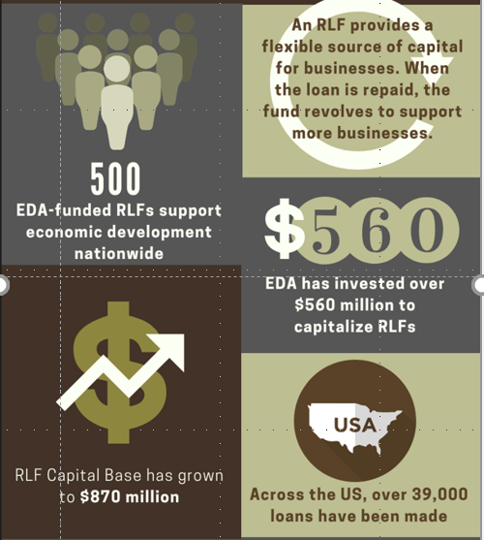
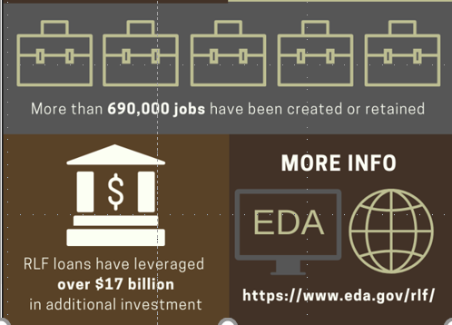

Slide 7
Economic Distress Criteria
EDA eligible areas have an unemployment rate that is, for the most recent 24-month period for which data is available
  at least one (1) percent greater than the national average unemployment rate; or
  per capita income that is, for the most recent period for which data is available, eighty (80) percent or less of the national average per capita income.
24-month average national unemployment rate: 5.44% (Source: ACS 2021 and ACS 2020 5-Year estimates) – areas with unemployment rate 6.44% or higher are eligible for EDA investment
National per capita income (PCI): $37,638 (Source: ACS 2021) – areas with PCI $30,110 or lower are eligible for EDA investment

Slide 8
Los Angeles County (cont’d.)
 | 24-Mo. Unemployment Rate | Per Capita Income
Los Angeles County | 6.70% | -
Artesia | 7.50% | $27,860
Azusa | - | $26,746
Baldwin Park | 6.50% | $22,831
Bell | 7.10% | $18,544
Bellflower | 7.70% | $27,074
Bell Gardens | - | $15,558
Beverly Hills | 7.90% | -
Bradbury | 8.70% | -
Burbank | 6.80% | -
Calabasas | 9.20% | -
Carson | 6.90% | -
Commerce | 6.50% | $22,039
Compton | 8.70% | $20,208
Covina | 6.90% | -
Cudahy | 8.20% | $15,018
Duarte | 7.30% | -
El Monte | 6.70% | $20,241
Gardena | - | $29,939
Glendale | 7.70% | -
Hawaiian Gardens | - | $20,987
Hawthorne | 7.30% | $28,796
Source: ACS 2021 and ACS 2020 5-Year estimates

Slide 9
Los Angeles County
 | 24-Mo. Unemployment Rate | Per Capita Income
Los Angeles County | 6.70% | -
Huntington Park | 10.10% | $17,308
Industry | 7.70% | $27,163
Inglewood | 7.40% | $28,211
Lancaster | 7.00% | $24,812
La Puente | 7.00% | $22,587
La Verne | 7.60% | -
Lawndale | 7.40% | $27,632
Long Beach | 6.70% | -
Los Angeles | 7.20% | -
Lynwood | 9.60% | $18,377
Maywood | - | $17,555
Montebello | 7.00% | $27,450
Norwalk | - | $26,756
Palmdale | 7.50% | $24,845
Paramount | - | $21,070
Pico Rivera | - | $27,225
Pomona | - | $24,006
Rosemead | - | $23,937
San Fernando | - | $25,241
Santa Fe Springs | - | $28,400
Santa Monica | 6.50% | -
South El Monte | - | $20,353
South Gate | 8.70% | $20,278
Vernon | 8.90% | $17,873
West Hollywood | 7.00% | -
Source: ACS 2021 and ACS 2020 5-Year estimates

Slide 10
Orange County
Source: ACS 2021 and ACS 2020 5-Year estimates

Slide 11
Riverside County
Source: ACS 2021 and ACS 2020 5-Year estimates

Slide 12
San Bernardino County
Source: ACS 2021 and ACS 2020 5-Year estimates

Slide 13
San Diego County
Source: ACS 2021 and ACS 2020 5-Year estimates

Slide 14
Investment Rates & Matching Share Requirements
Projects located in regions in which: | Maximum allowable investment rates (percentage)
(A) The 24-month unemployment rate is at least 225% of the national average; or | 80
(B) The per capita income is not more than 50% of the national average | 80
(C) The 24-month unemployment rate is at least 200% of the national average; or | 70
(D) The per capita income is not more than 60% of the national average | 70
(E) The 24-month unemployment rate is at least 175% of the national average; or | 60
(F) The per capita income is not more than 65% of the national average | 60
(G) The 24-month unemployment rate is at least one percentage point greater than the national average; or | 50
(H) The per capita income is not more than 80% of the national average | 50
Source: https://www.ecfr.gov/current/title-13/chapter-III/part-301

